Slide 1
Tutorial Arduino IDE
For the ESP 8266

Slide 2
Hardware - Setup
We begin with the hardware setup of the ESP

Slide 3
Hardware - Setup
USB Cable
USB -> UART Converter
You can also use an Arduino -> Bridge RST to GND
5V to 3.3V Converter
Breadboard for connecting pins / reset button
Connect like shown in the hardware diagram

Slide 4
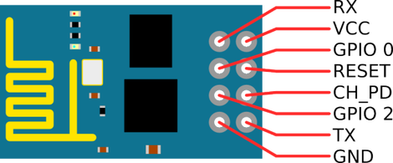
Hardware - Setup
Here is an explanation of the different pins
ID | Usage
RX | Serial Input
VCC | Voltage Supply
GPIO 0 | HIGH = Flashing
RESET | LOW = RESET (Pullup to high)
GPIO 2 | HIGH
CH_PD | LOW = Power Down (Chip not running)
GND | Ground
TX | Serial Output

Slide 5
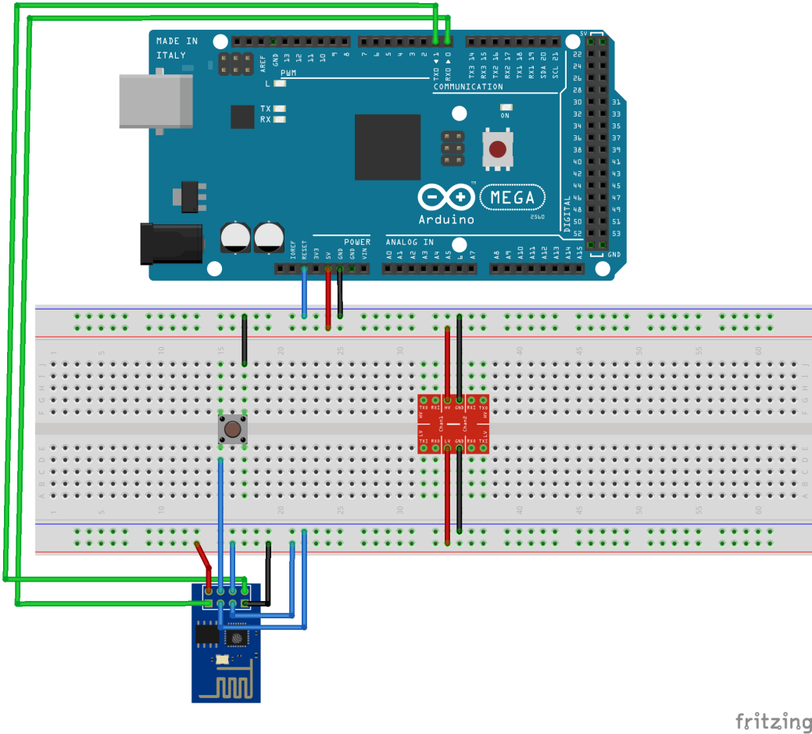
Hardware - Setup
Connect the pins as shown in the diagram
ID | Connect to
RX | TX on Arduino
VCC | 3.3V
GPIO 0 | GND
RESET | Button on breadboard
GPIO 2 | 3.3V
CH_PD | 3.3V
GND | GND
TX | RX on Arduino

Slide 6
Software - Setup
After doing the hardware setup we can no attempt the software setup.

Slide 7
Software - Setup
Download the latest Version from https://www.arduino.cc/en/Main/Software
Install IDE
Press „Datei“ -> „Voreinstellungen“ and add http://arduino.esp8266.com/stable/package_esp8266com_index.json under „zusätzliche Boardverwalter-URLs“

Slide 8
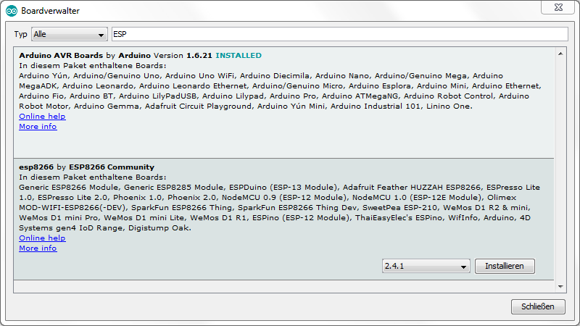
Software - Setup
Now you can download the ESP board support by clicking on „Werkzeuge“ -> „Board“ -> „Boardverwalter“ and type in „ESP“

Slide 9
Software - Setup
Now create your code or copy from

